Slide 1
Reverse Engineering tools a DevOps Engineer can use
Jean-Marcel Belmont
@jbelmont80
https://www.marcelbelmont.com
Software Engineer
FoodLogiQ
Notes:
Good Evening!
My name is Jean-Marcel Belmont and I am here to talk about Reverse Engineering tools that DevOps folks can use

Slide 2
What is Reverse Engineering?
“Reverse engineering, also called back engineering, is the process by which a man-made object is deconstructed to reveal its designs, architecture, or to extract knowledge from the object; similar to scientific research, the only difference being that scientific research is about a natural phenomenon.”
- Reverse Engineering Wikipedia Post
Notes:
Here is the definition of Reverse Engineering as Wikipedia explains it.
Reverse Engineering software to me is not about modifying the software but simply examining the software

Slide 3


Notes:
When reverse engineering a piece of software you are effectively putting it under a microscope!

Slide 4
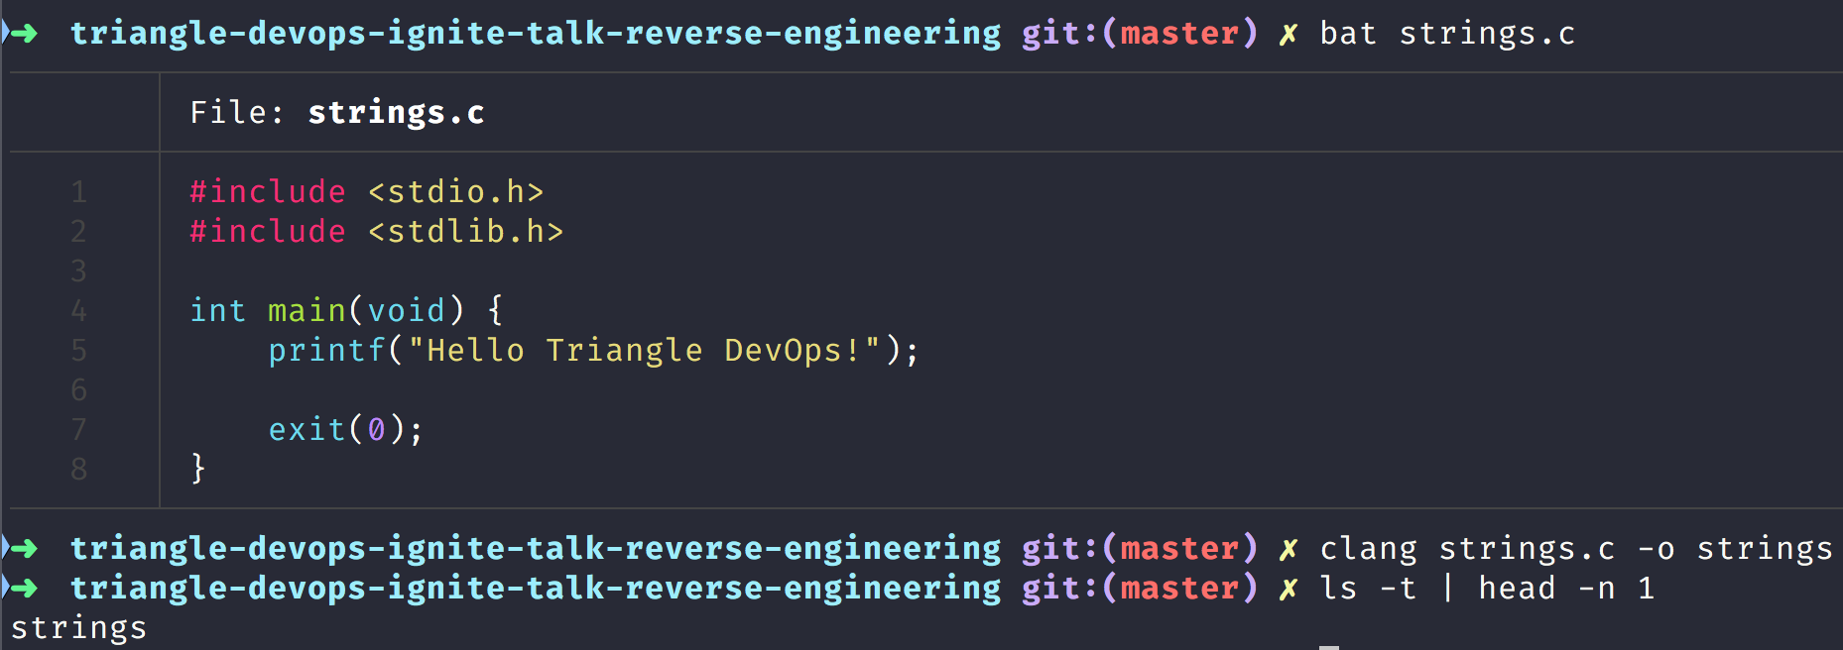
C Hello World Example
Notes:
Here is basic hello world c program that we compile with the clang compiler and generate a strings binary executable but imagine you can binary executable file and want to do some initial probing!

Slide 5
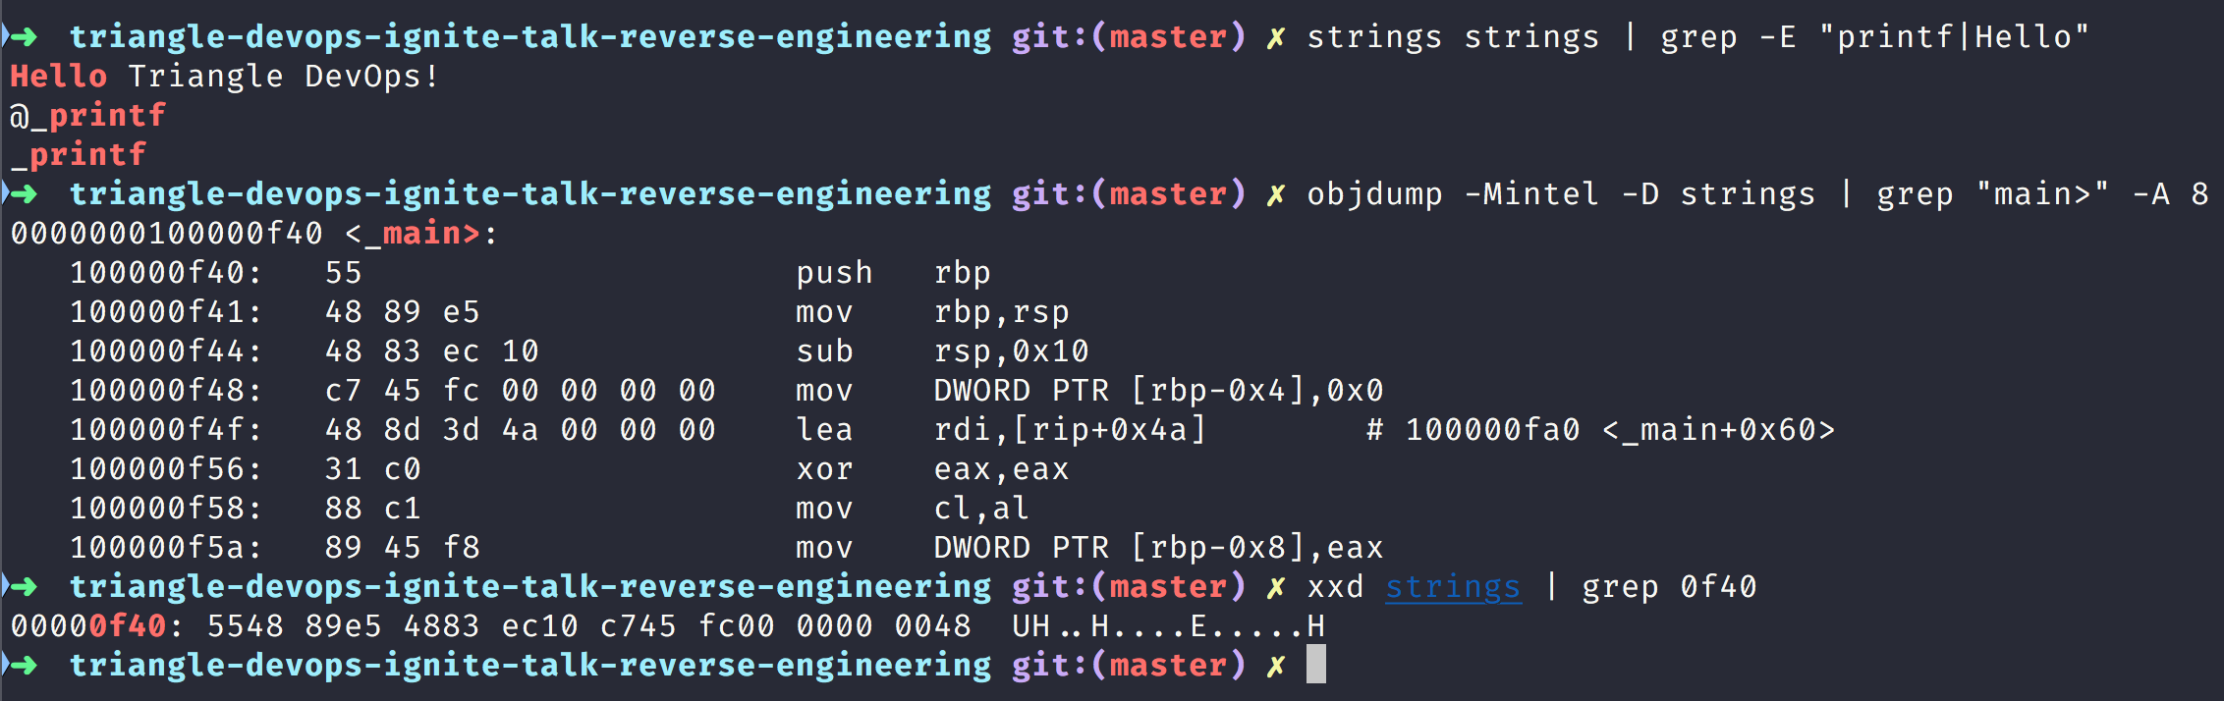
Basic Unix Tools for Reverse Engineering
Notes:
In the first command example we simply use the strings command to simply print the printable characters in the program and grep for the printf command and Hello Text
In the second command example we used the objdump command to get an intel assembly dump of the strings command and then grep for the main function!
In the third command we use the xxd command to get a hex dump for the address 0f40

Slide 6


Real World Hacking Tools
Notes:
Anybody here ever watched the show Mr. Robot.
They hired a professional security consultant in the show that uses real world security tools
In the final episode of season 2 tyrell uses radare2

Slide 7
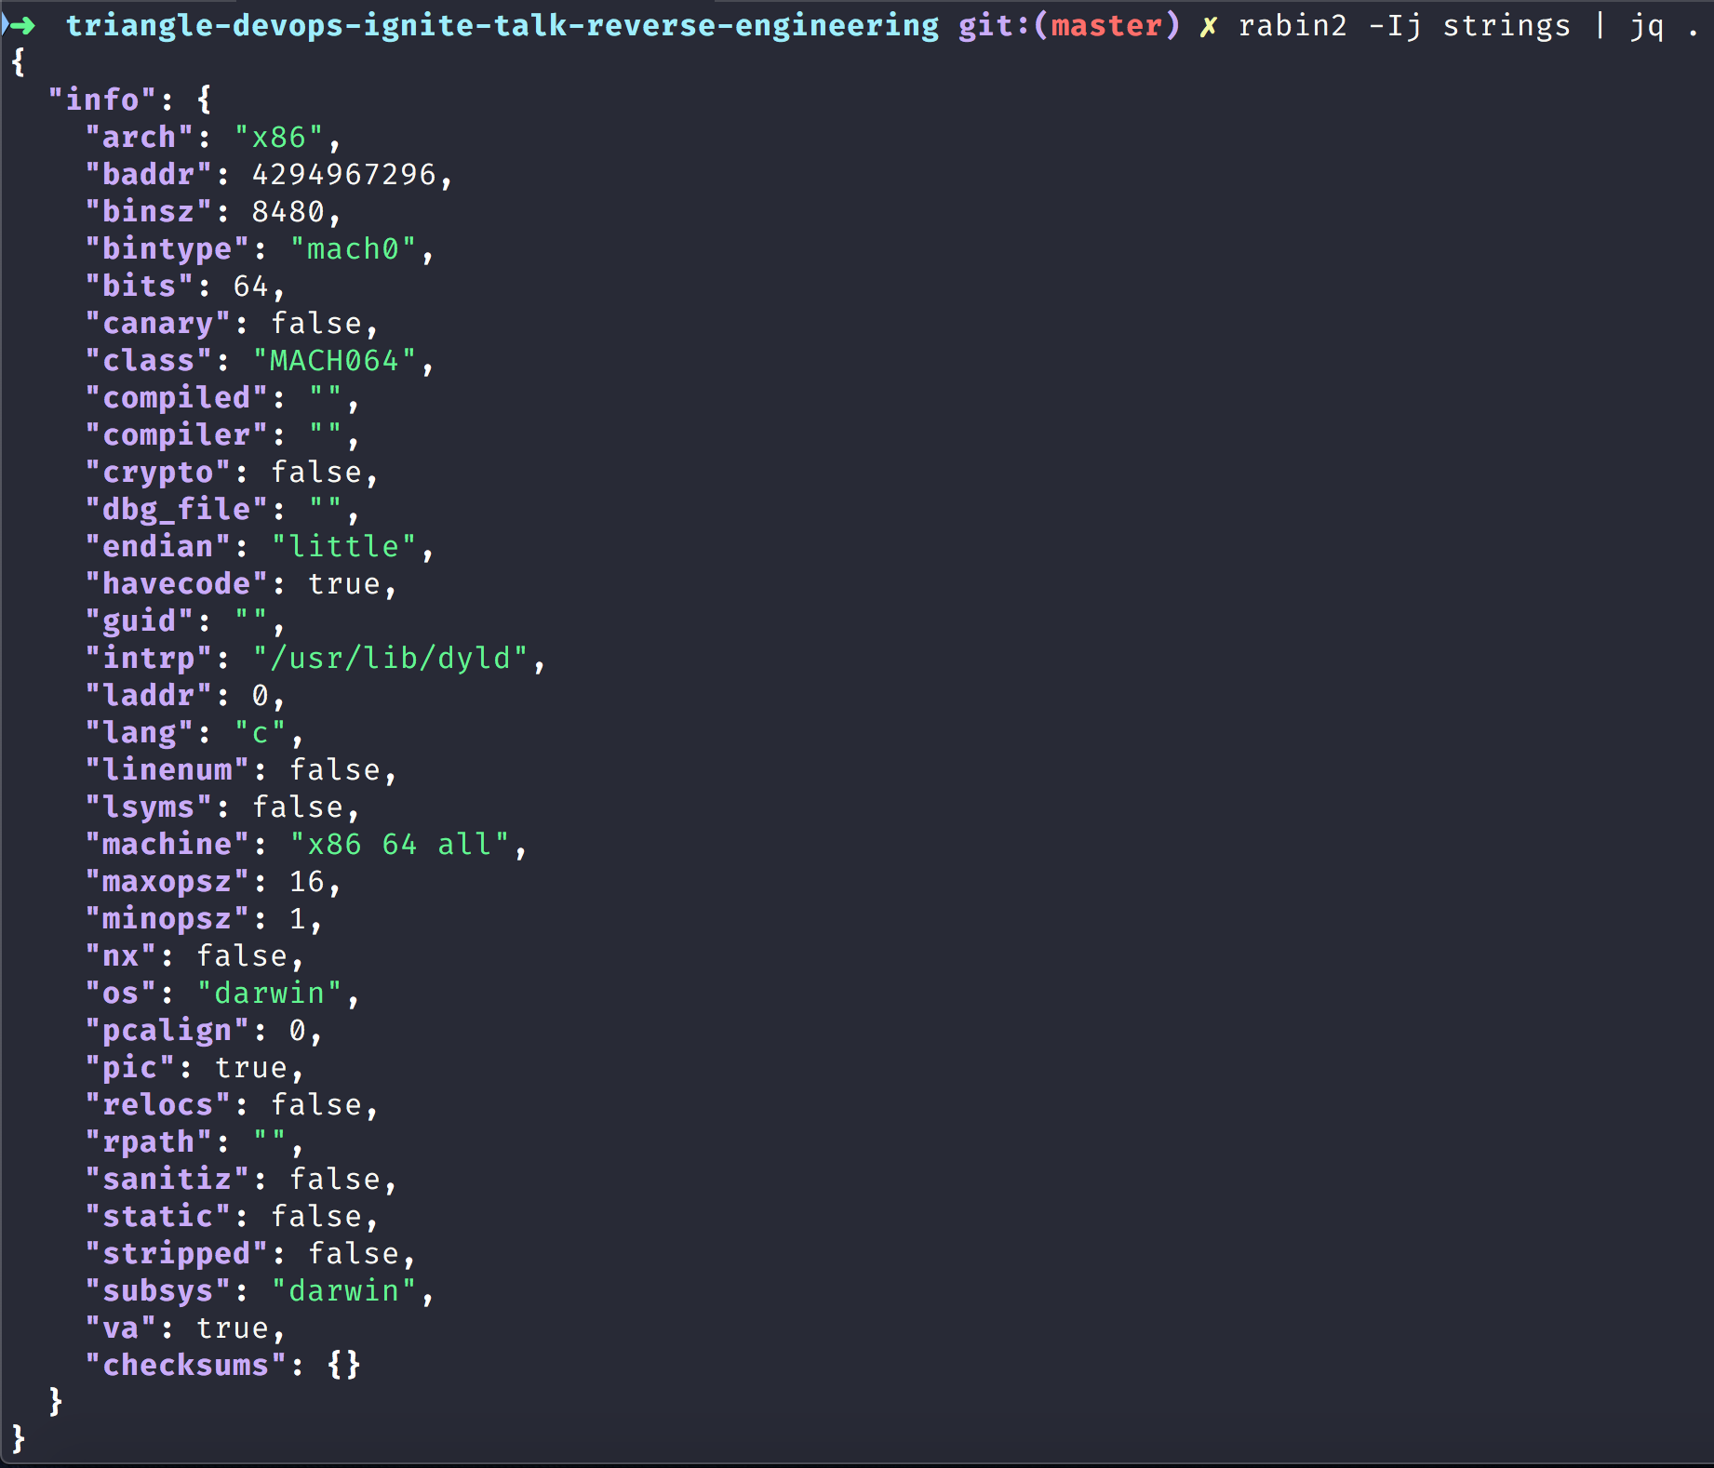
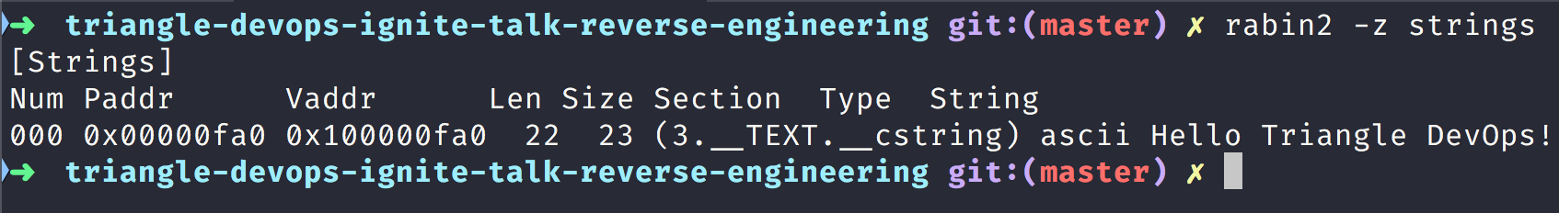
Using radare2 tools such as (rabin2) to inspect binary executable
Notes:
Notice here that we get some information on the architecture of the strings binary executable.
It tells us information like it was built with a 64 bit computer architecture on Darwin or the Mac OS X operating system

Slide 8
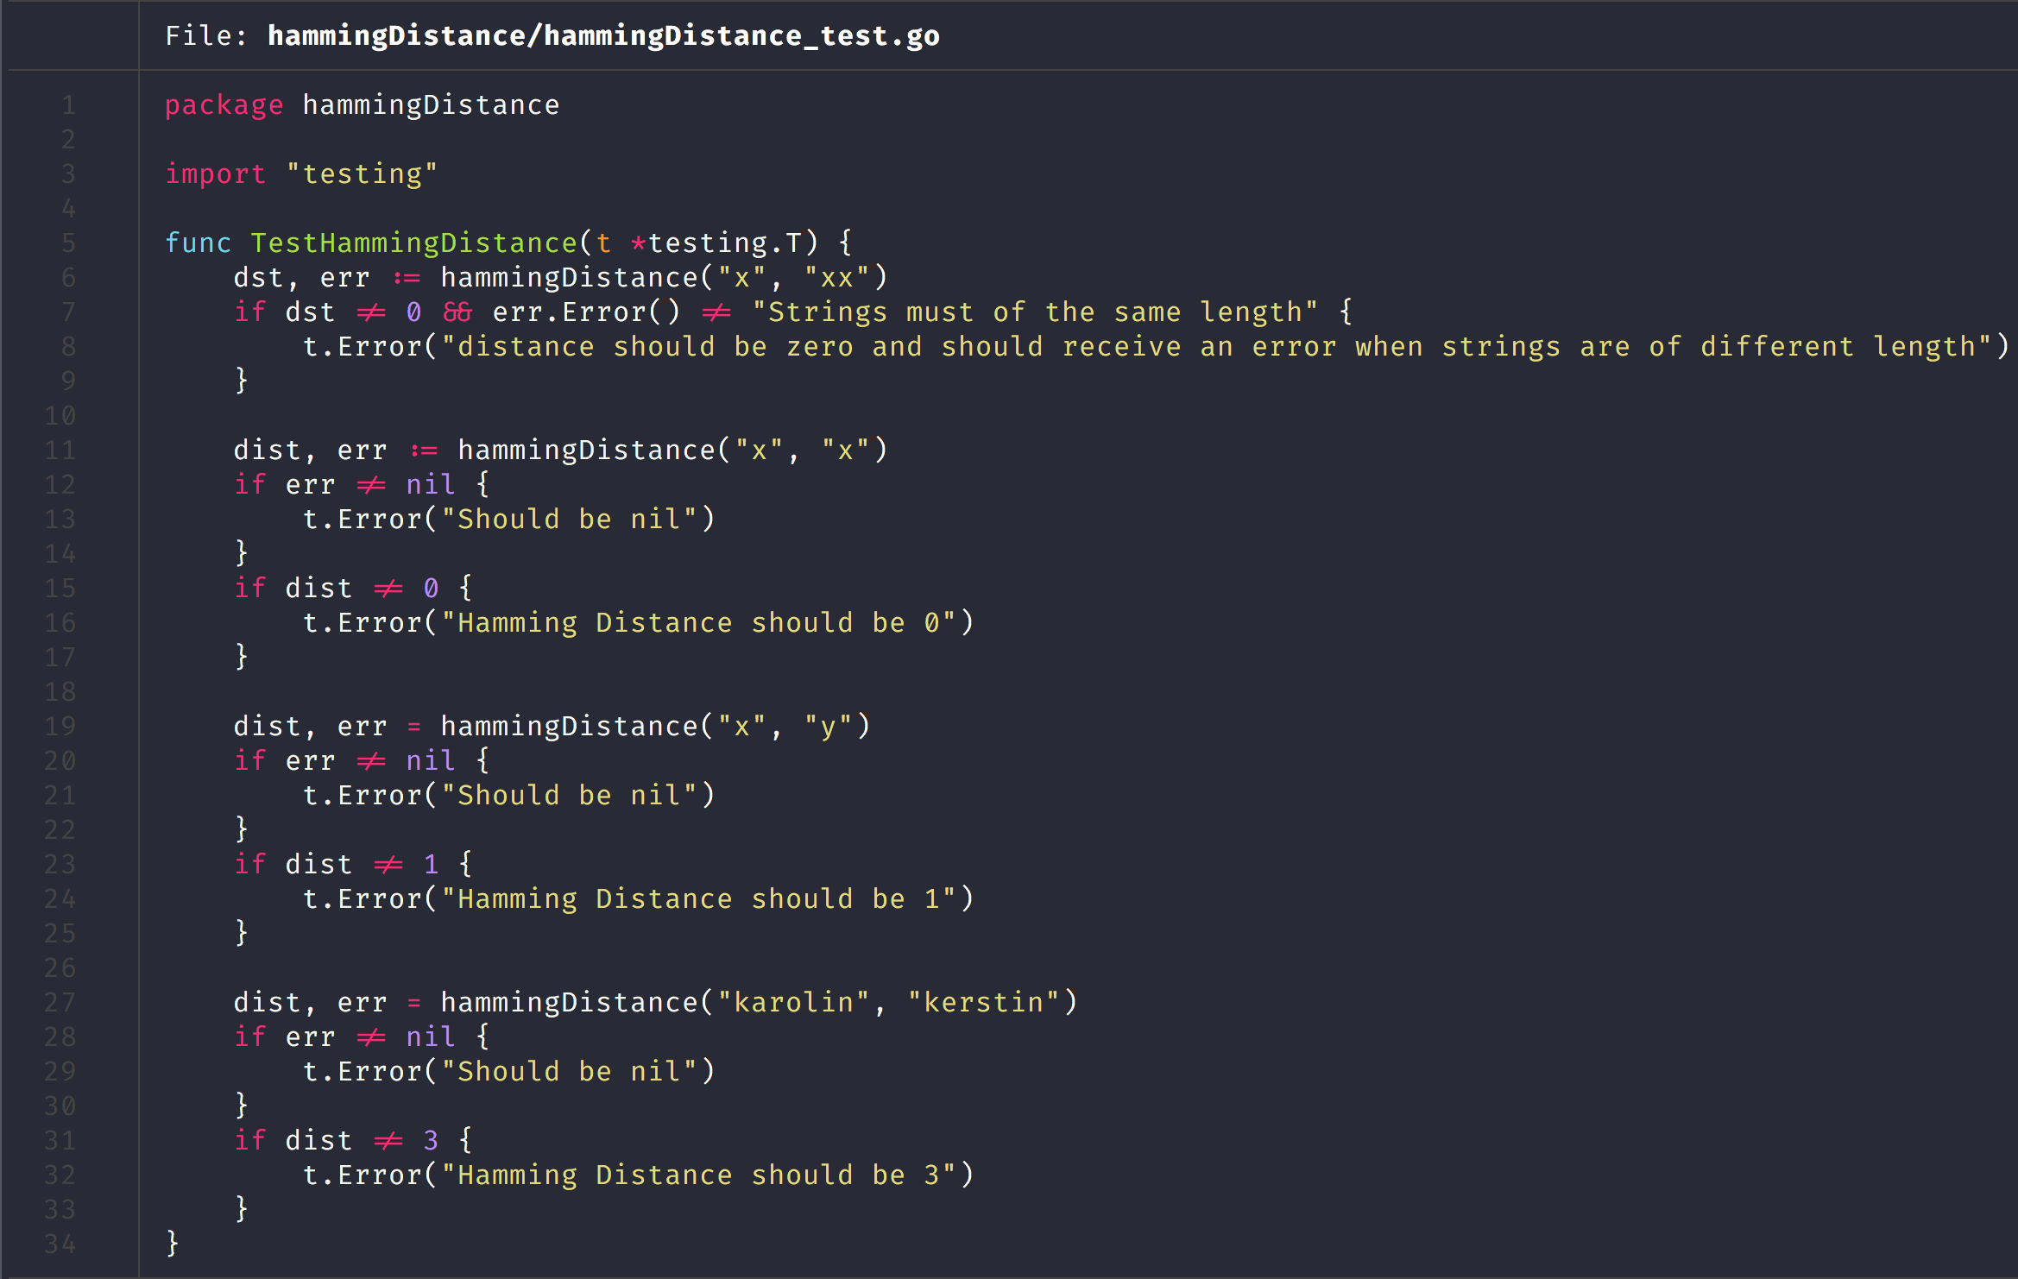
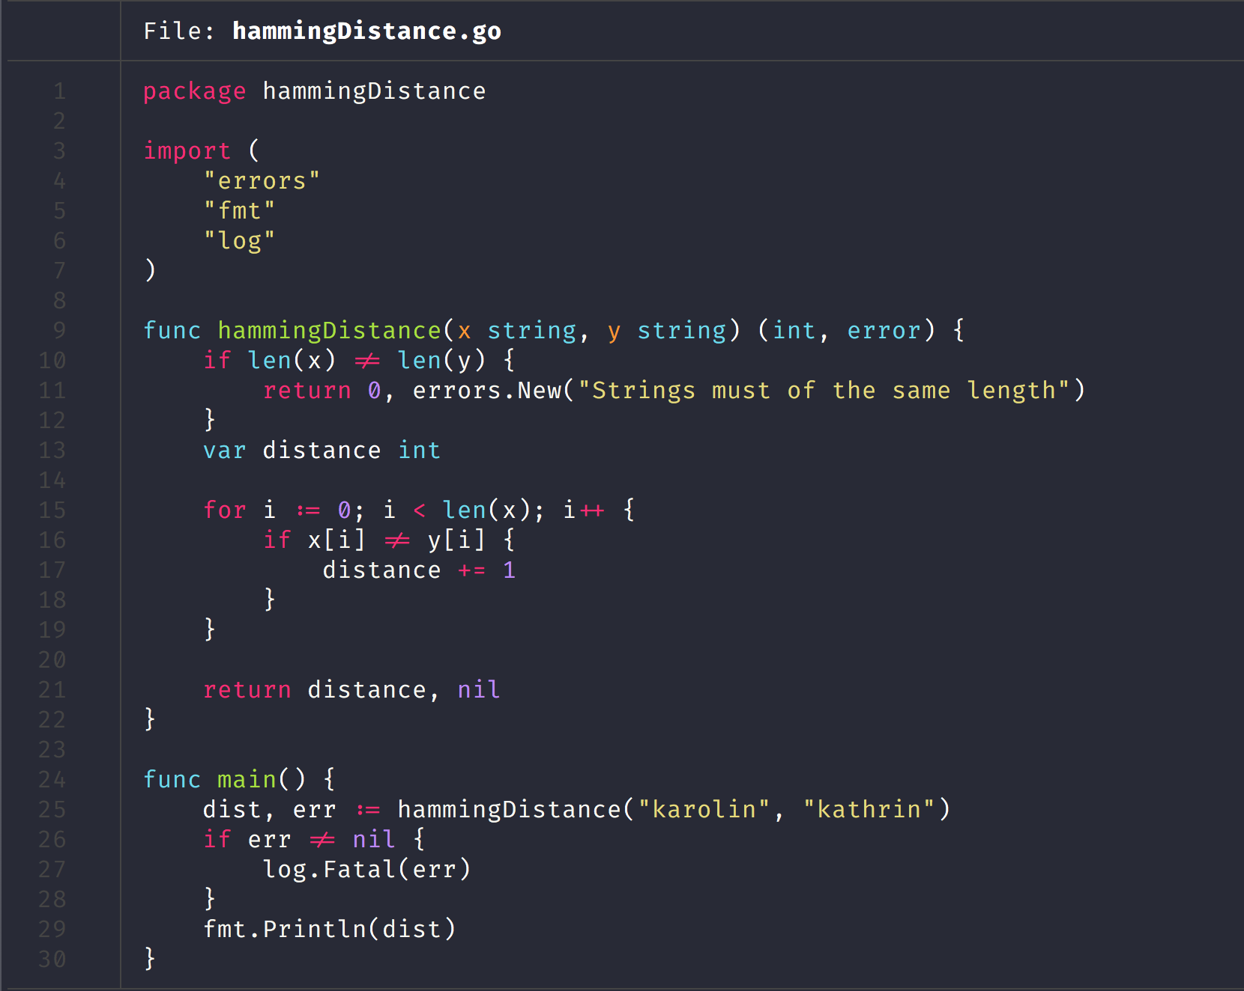
Golang Program implementing Hamming Distance Algorithm
Notes:
So here is a bit of source code that implements the hamming distance algorithm
In information theory, the Hamming distance between two strings of equal length is the number of positions at which the corresponding symbols are different. In other words, it measures the minimum number of substitutions required to change one string into the other, or the minimum number of errors that could have transformed one string into the other. In a more general context, the Hamming distance is one of several string metrics for measuring the edit distance between two sequences. It is named after the American mathematician Richard Hamming.

Slide 9
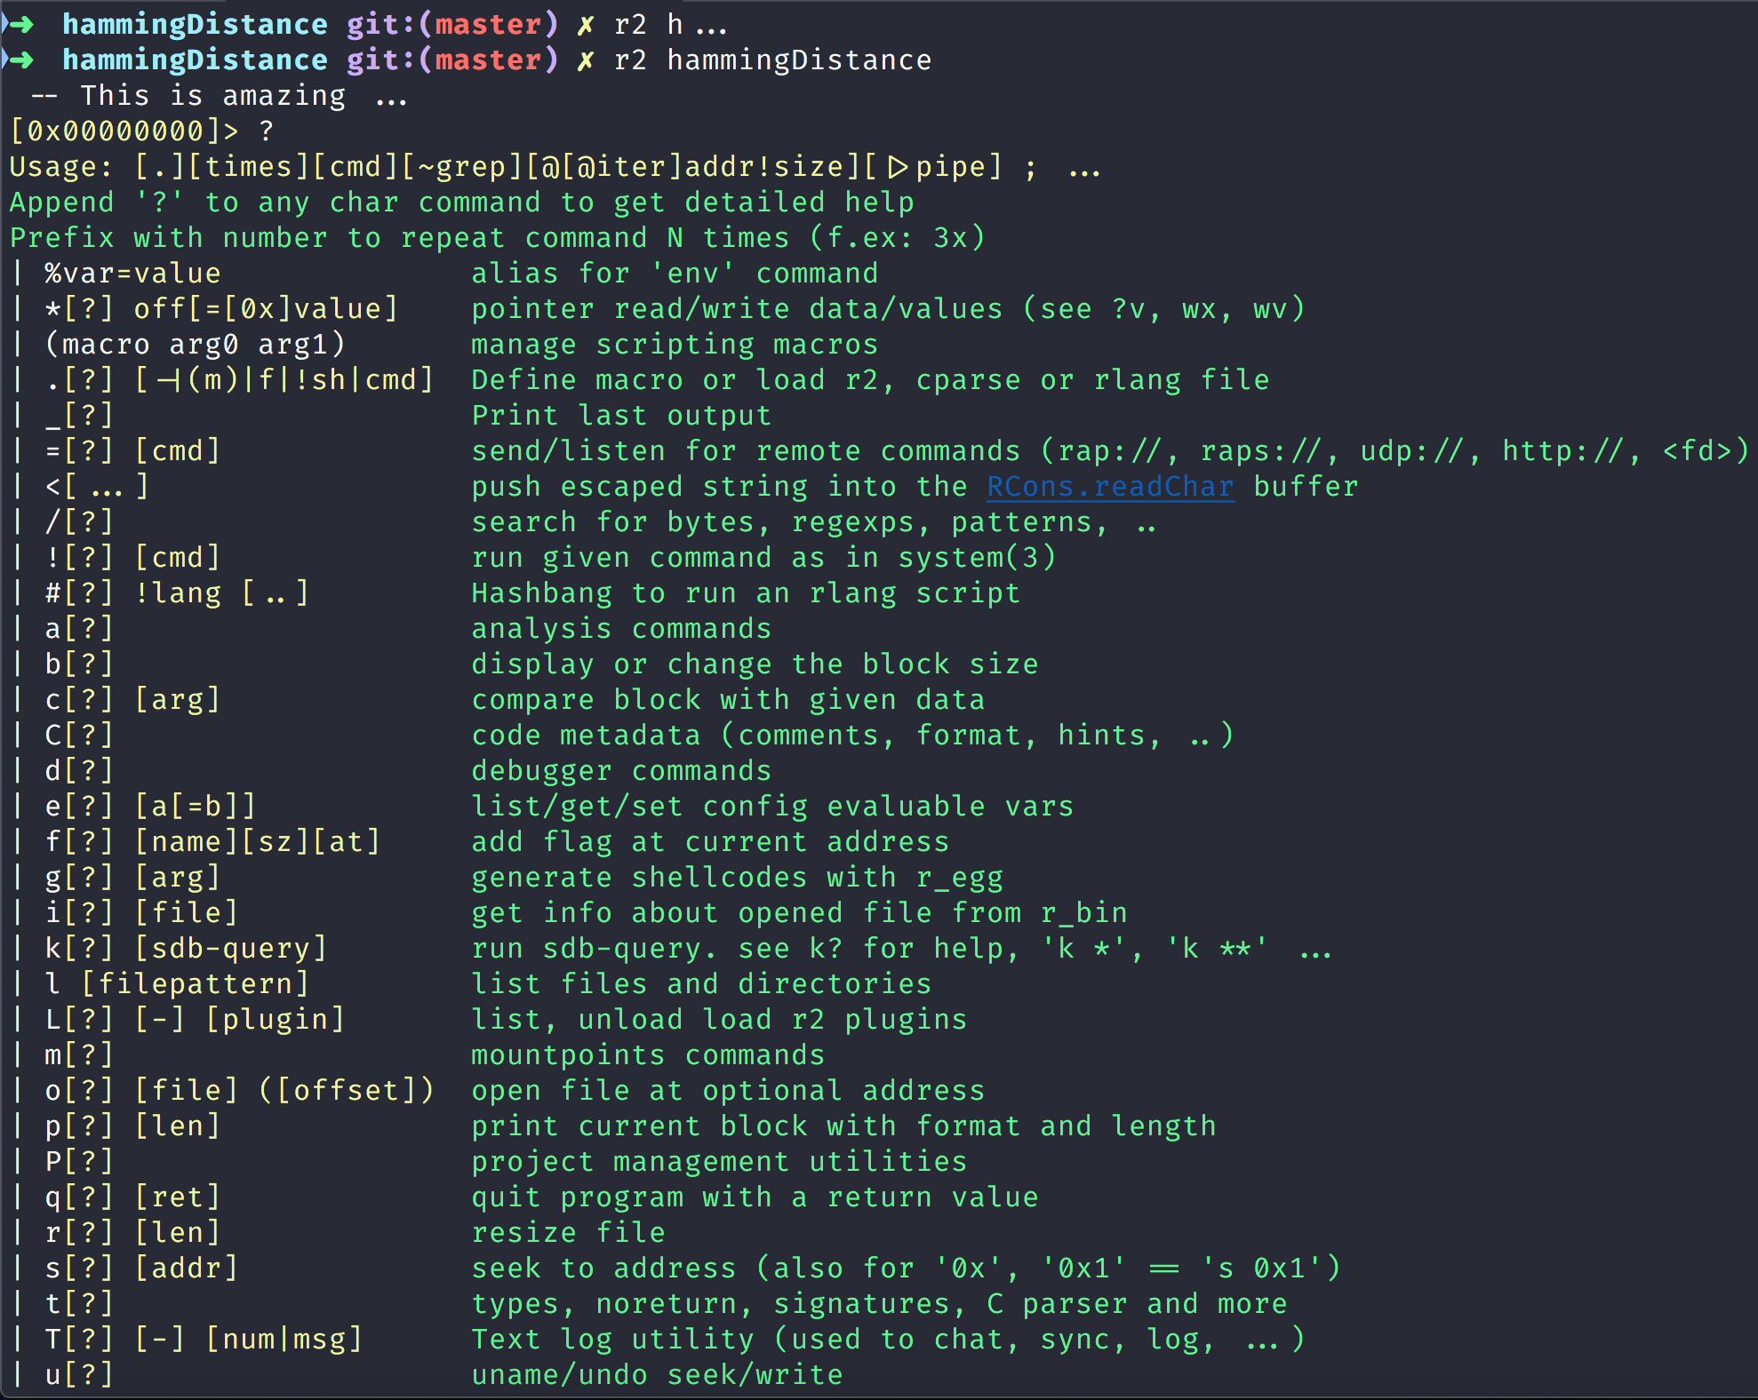
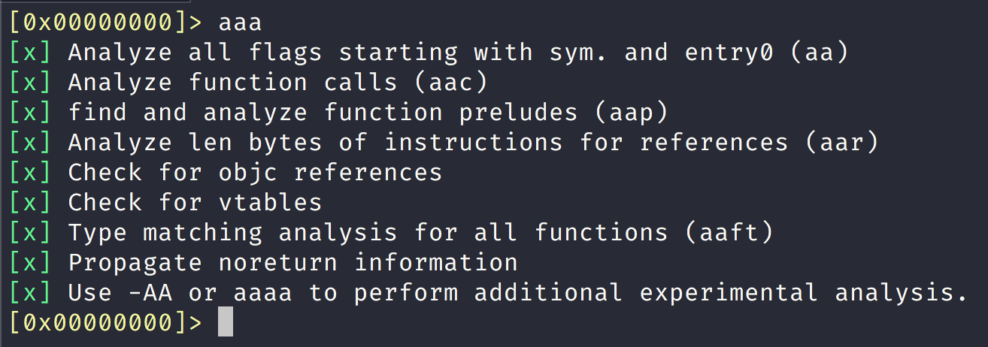
Loading Binary Executable into Radare
Notes:
Notice here that first load our binary executable into radare and then use the ? to get help text for radare.
We then analyze the binary with the a command you get increased verbosity with each added a in radare2.
You need to run aa or (analyze) since radare2 does not examine the binary by default

Slide 10
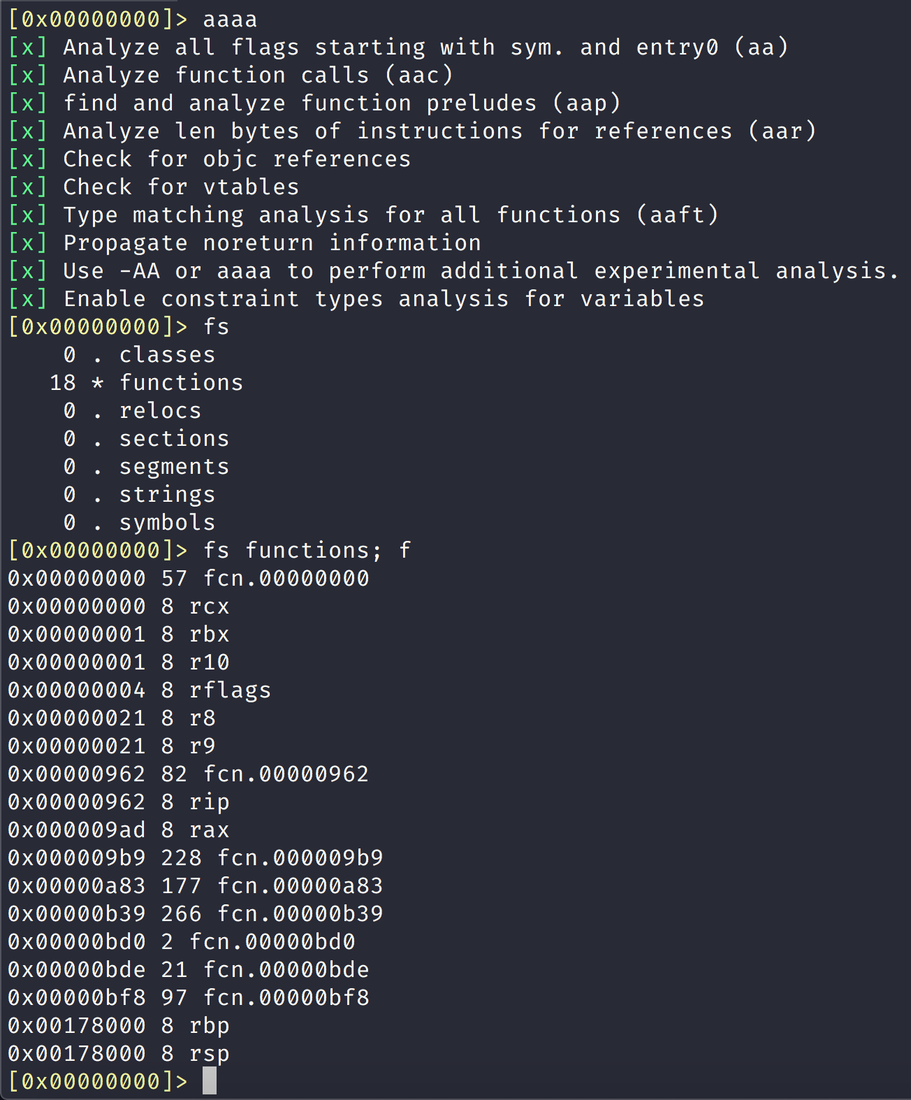
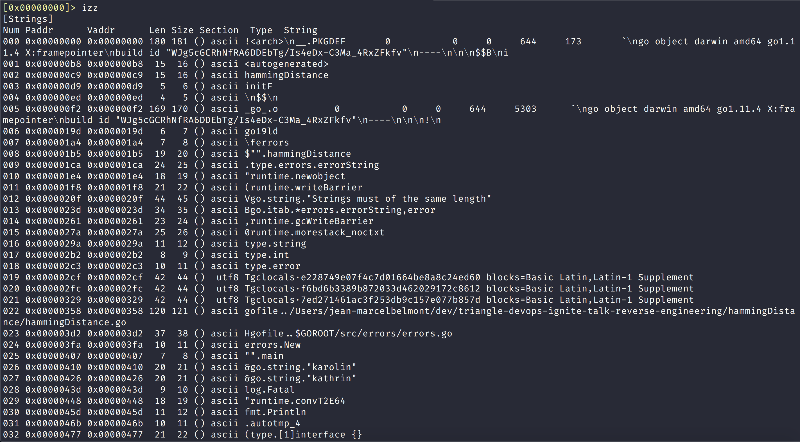
Analyzing binary with radare shell commands
Notes:
In here with analyze the binary executable and in particular we look at flag spaces in the binary executable
Then we look at all the strings that exist in the binary executable like we did with the strings command in the unix tools slide

Slide 11
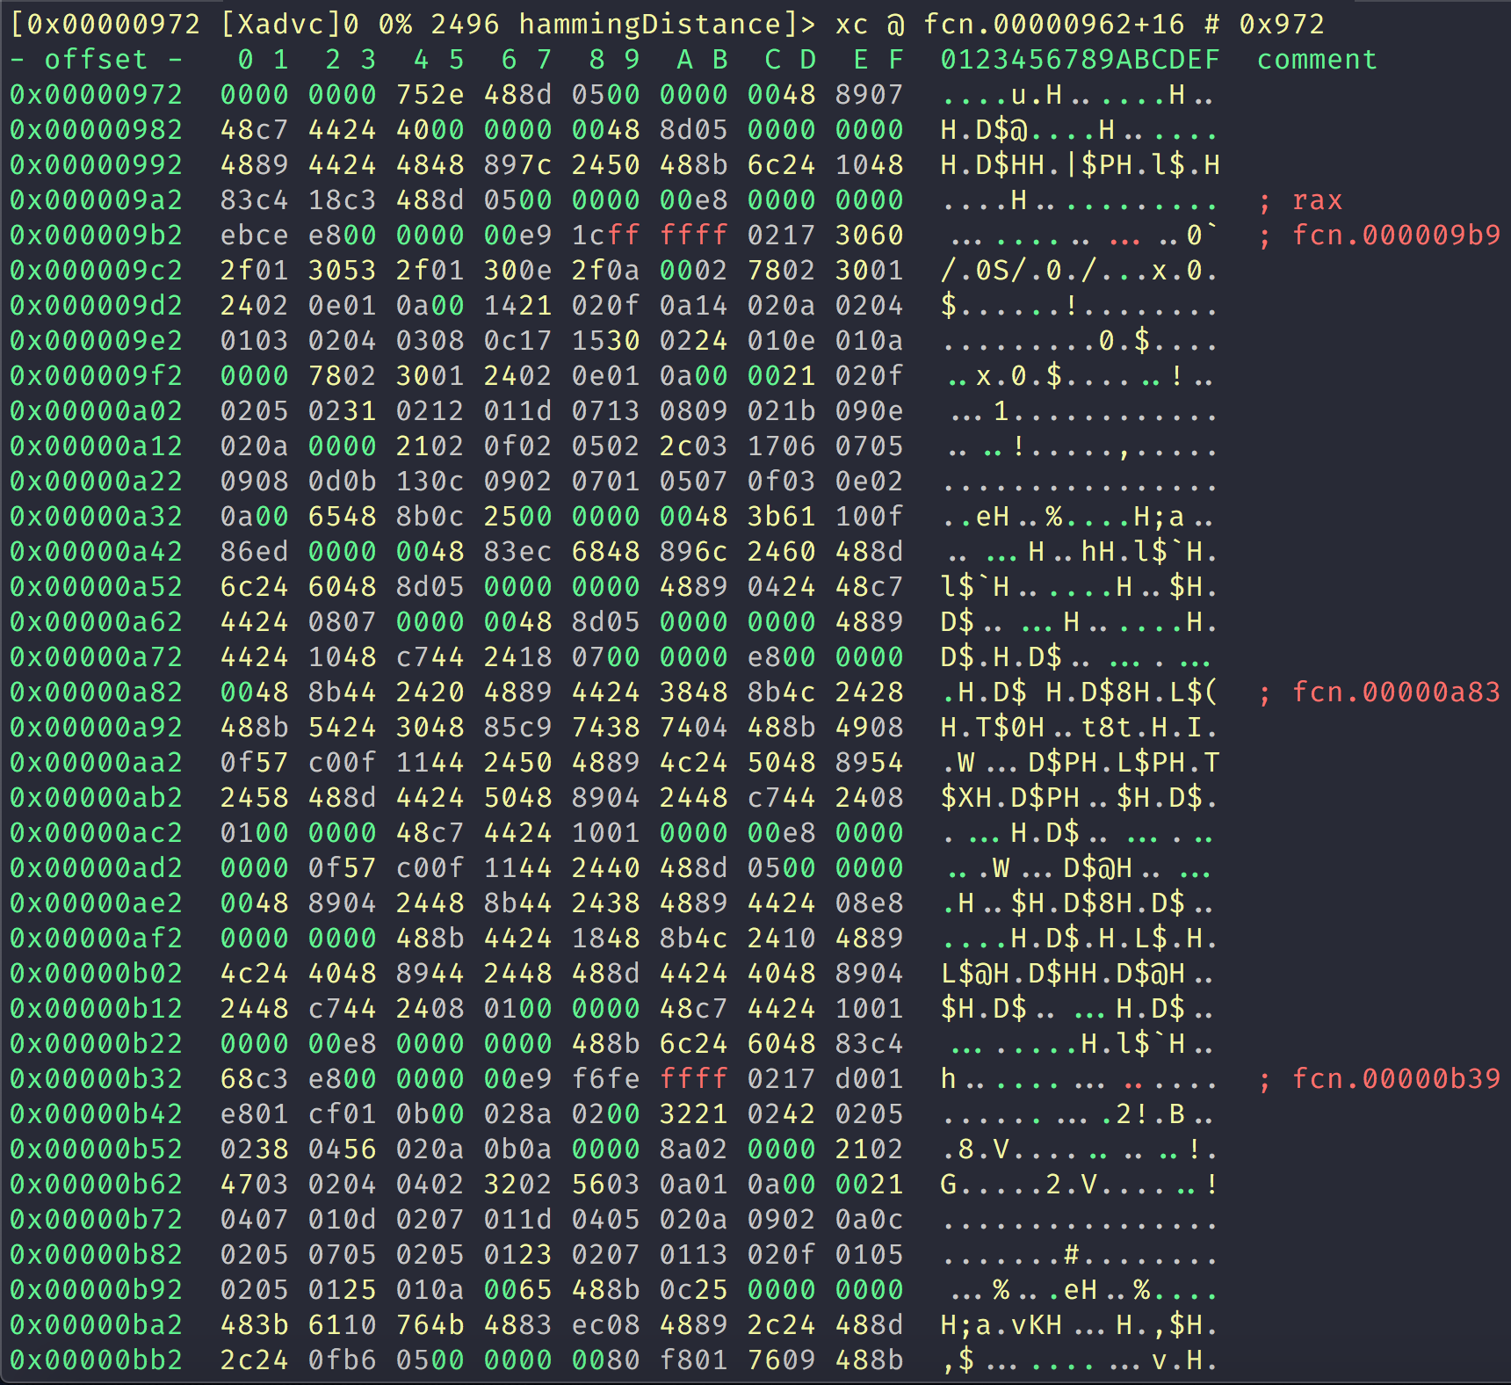
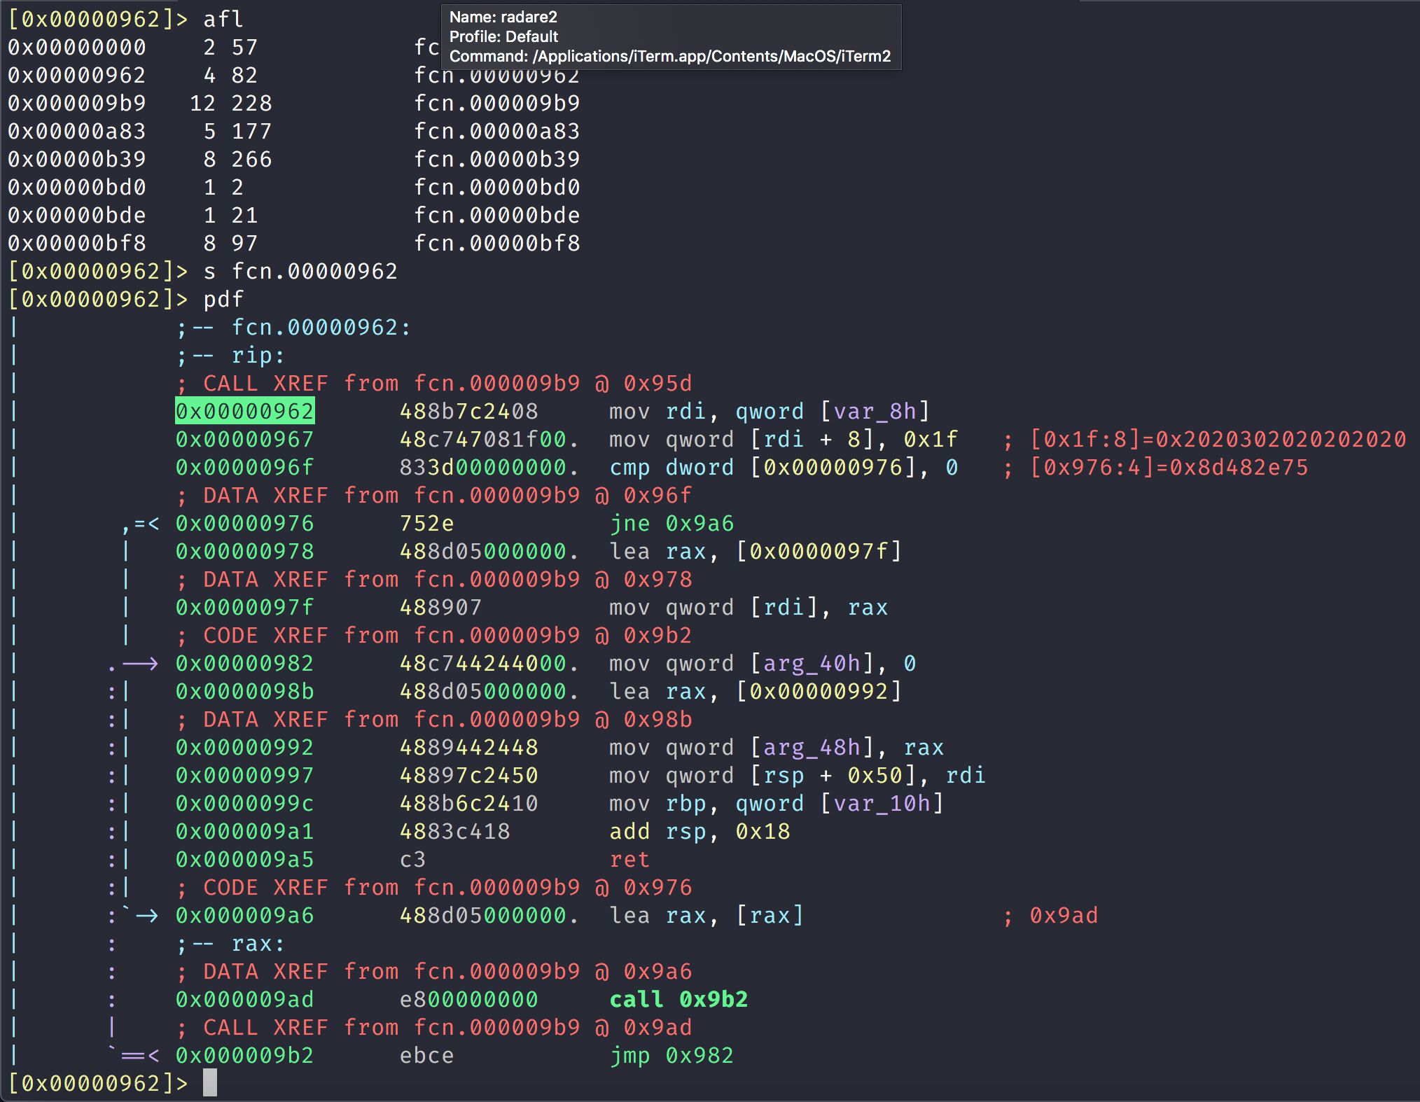
Continued Radare2 Binary Analysis
Notes:
Here we list all the functions in the binary and then we run s to seek to the particular memory address and then we run pdf to
Dissassemble and run a summary of the disassembly.
In the other screenshot we look at a visual representation of the memory addresses and are in vi mode like vim

Slide 12

Debugger Land
Notes:
Now let us enter the wide world of debuggers. There are many debuggers to choose from like gdb, lldb and others.
Debuggers are powerful ways to analyze how a binary executable works and more

Slide 13

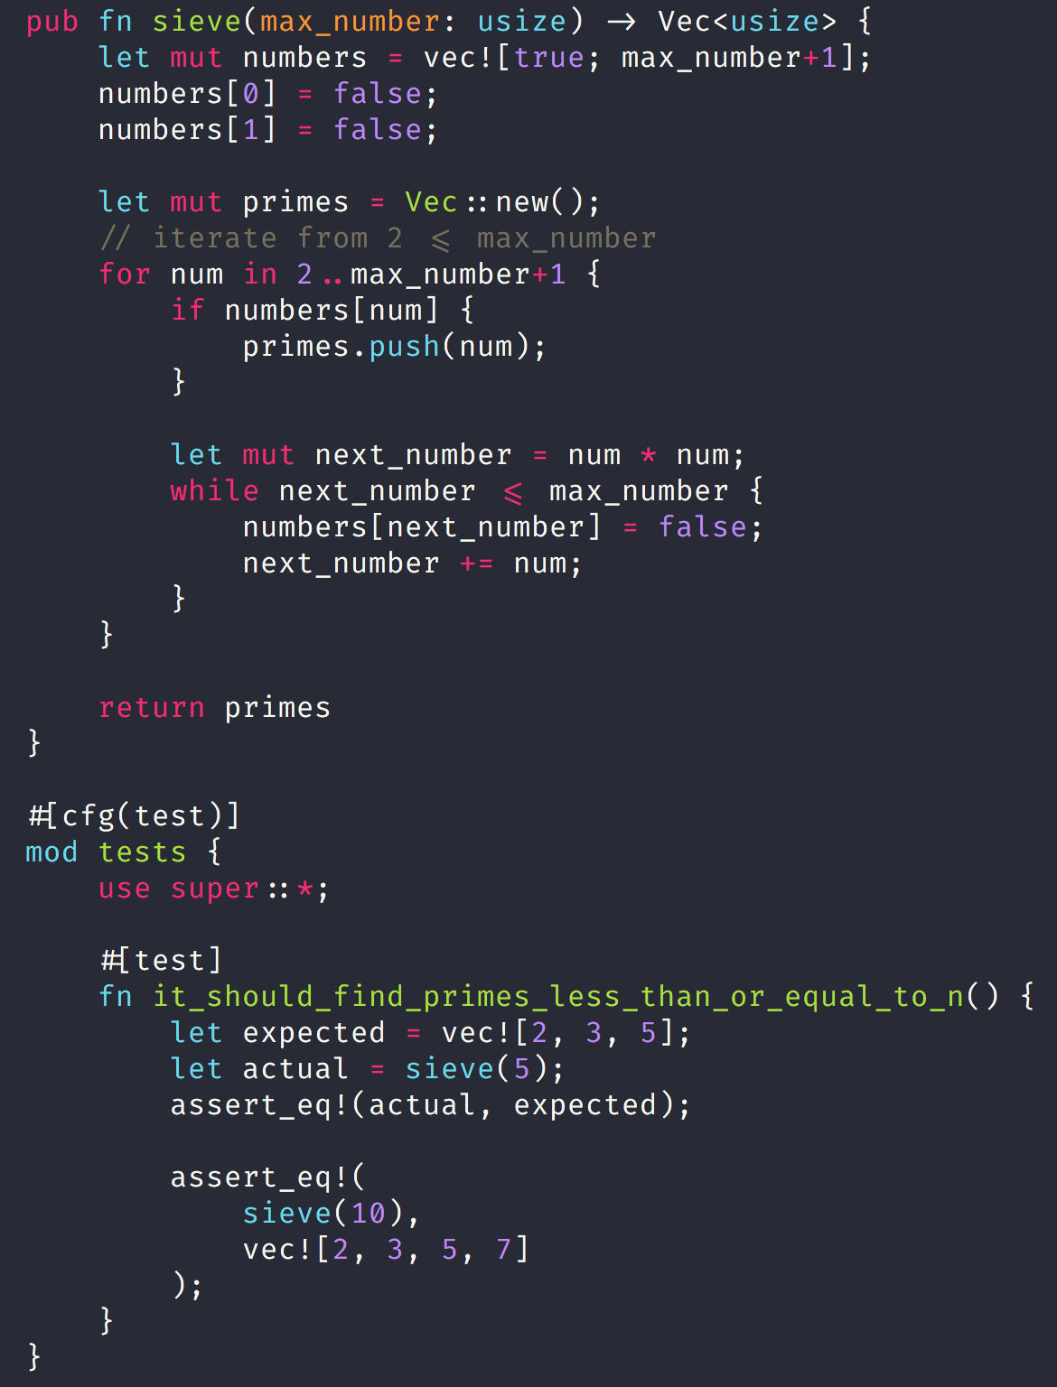
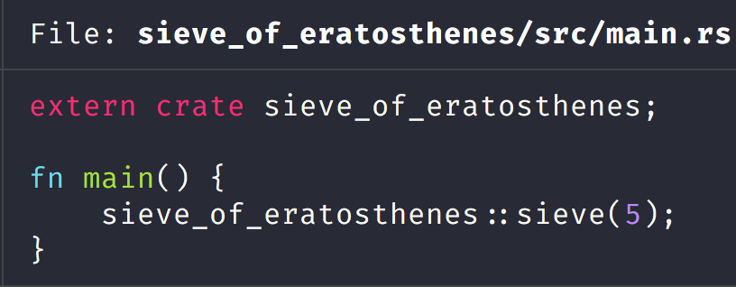
Sieve of Eratosthenes Algorithm
Notes:
Here we looking at a program written in rust that naively implements the sieve of Eratosthenes which is an ancient mathematical algorithm to find prime numbers.
We will debug this program using the rust-lldb wrapper which wraps lldb calls so that you can debug with rust language source code.

Slide 14
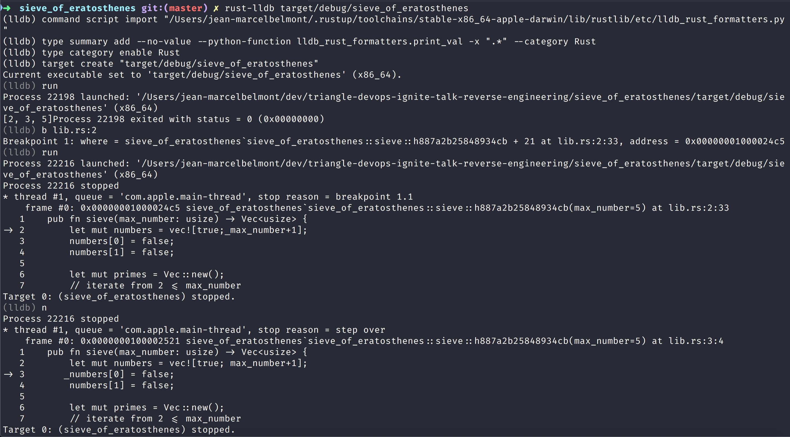
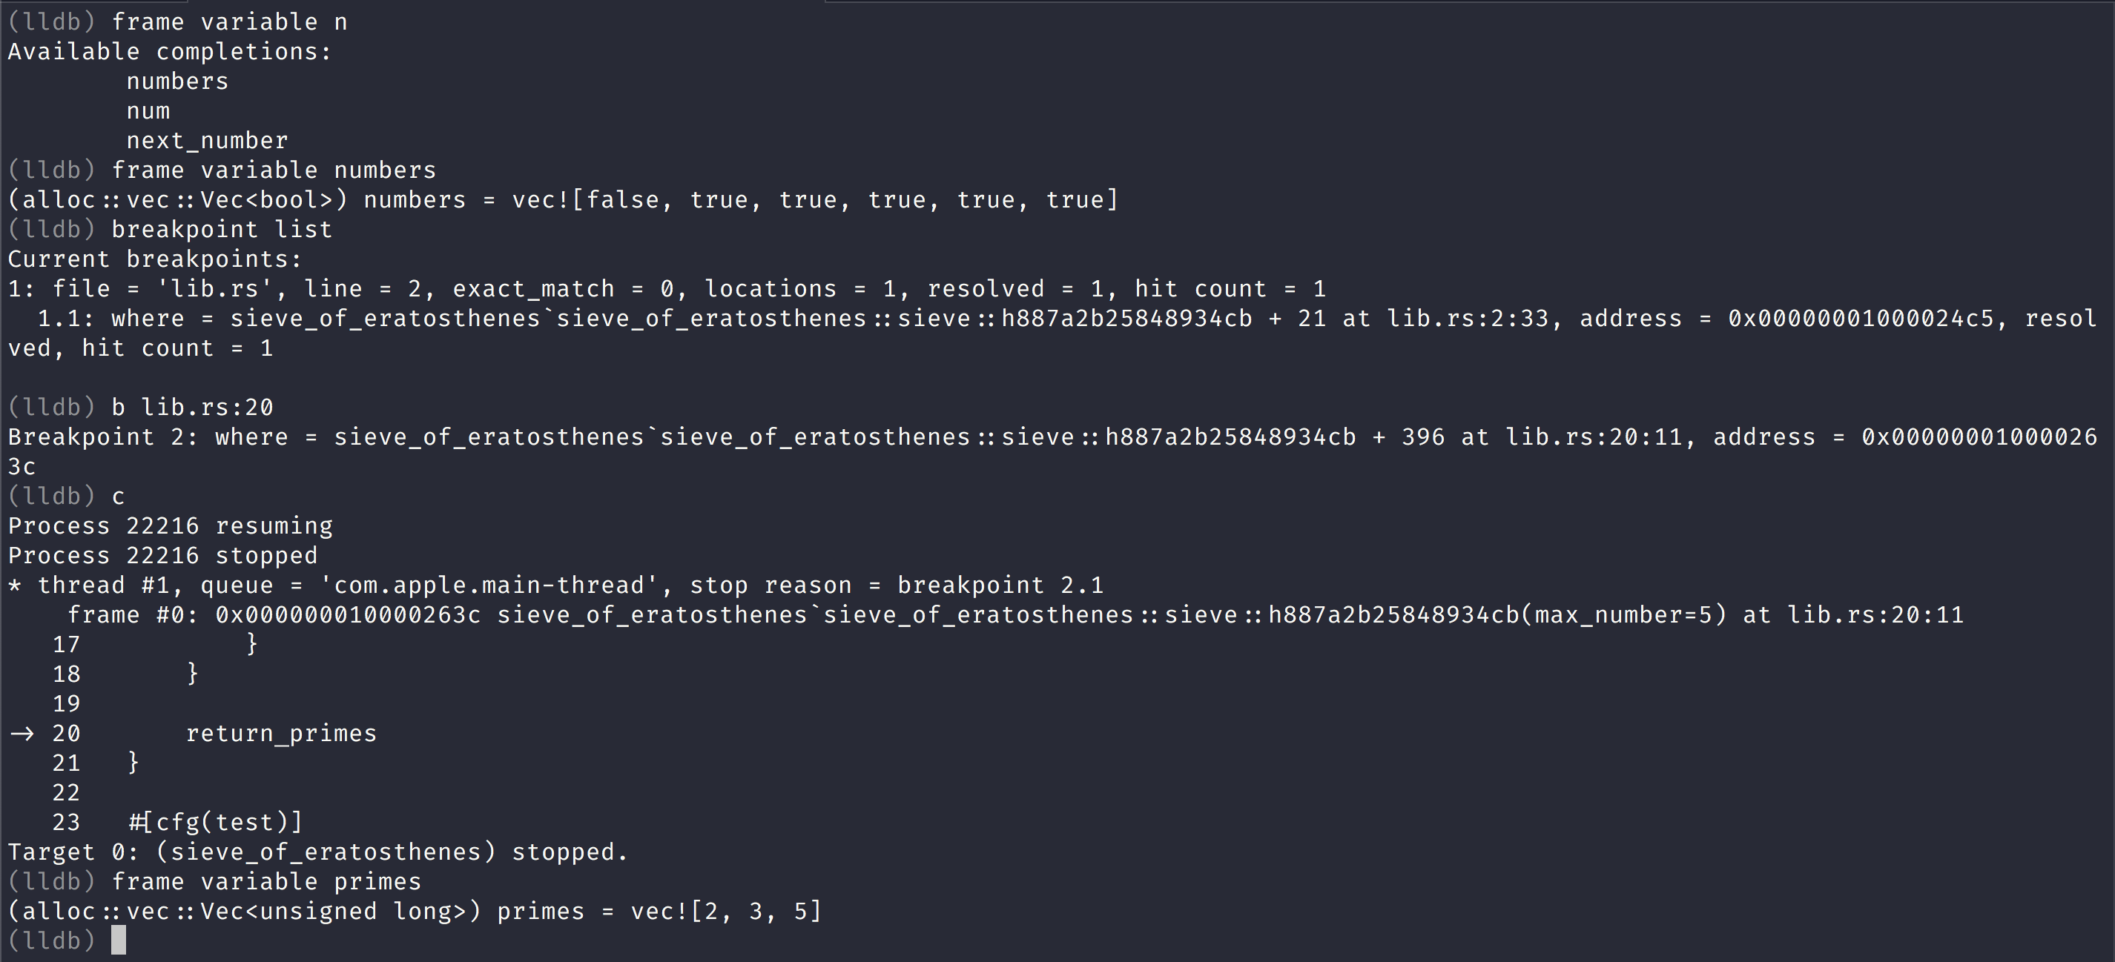
Setting breakpoints and evaluating stack frame variables with lldb debugger
Notes:
Here we are interactively starting rust-lldb for a sieve of Eratosthenes algorithm.
We are setting breakpoints, resuming execution and evaluating stack frame variables with rust-lldb.

Slide 15
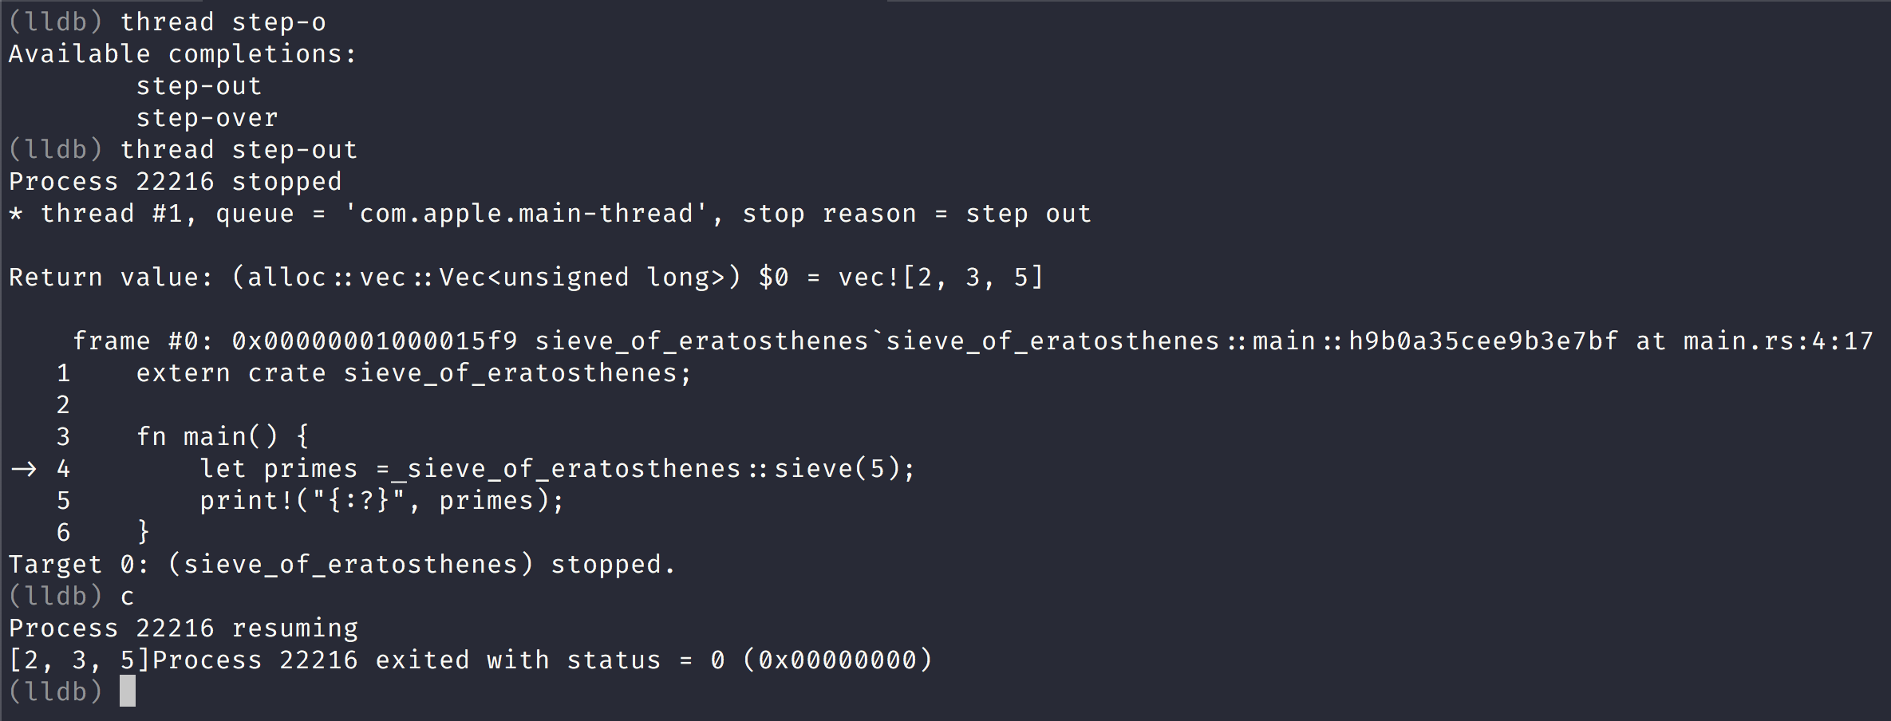
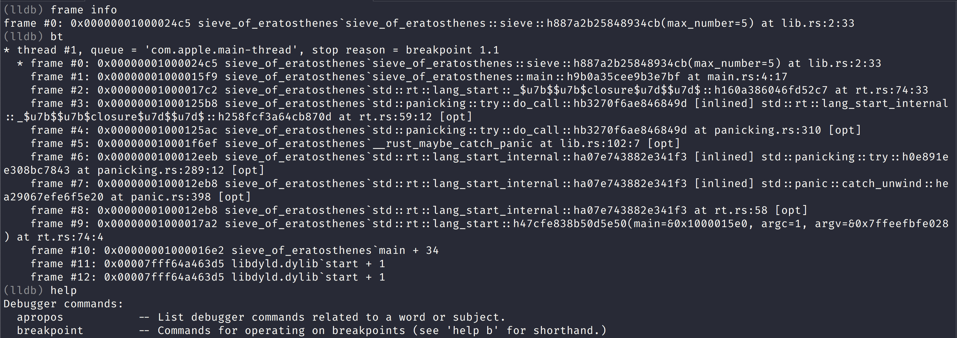
Stepping into functions, looking at stack frame information and help information with lldb.
Notes:
Here we step out of the current stack which is the sieve function defined in lib.rs in a rust program.
We then resume execution and finally print out the prime values to standard output.

Slide 16

Using Reverse Engineering Ghidra tool by NSA
Notes:
The NSA has recently open sourced the Ghidra Reverse Engineering tool and it is available in Github.
If we have some final fantasty geeks the ghidra is a powerful monster that is stronger than the Hydra

Slide 17
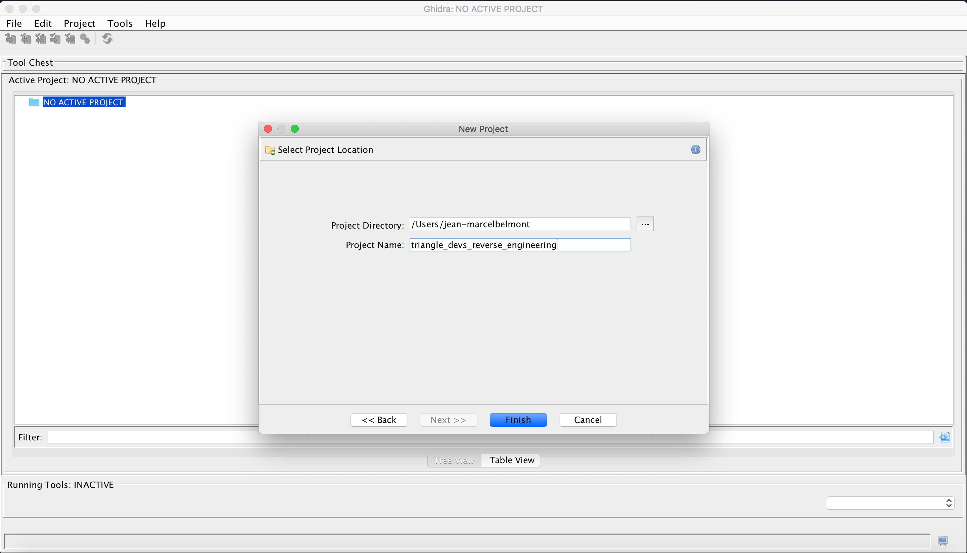
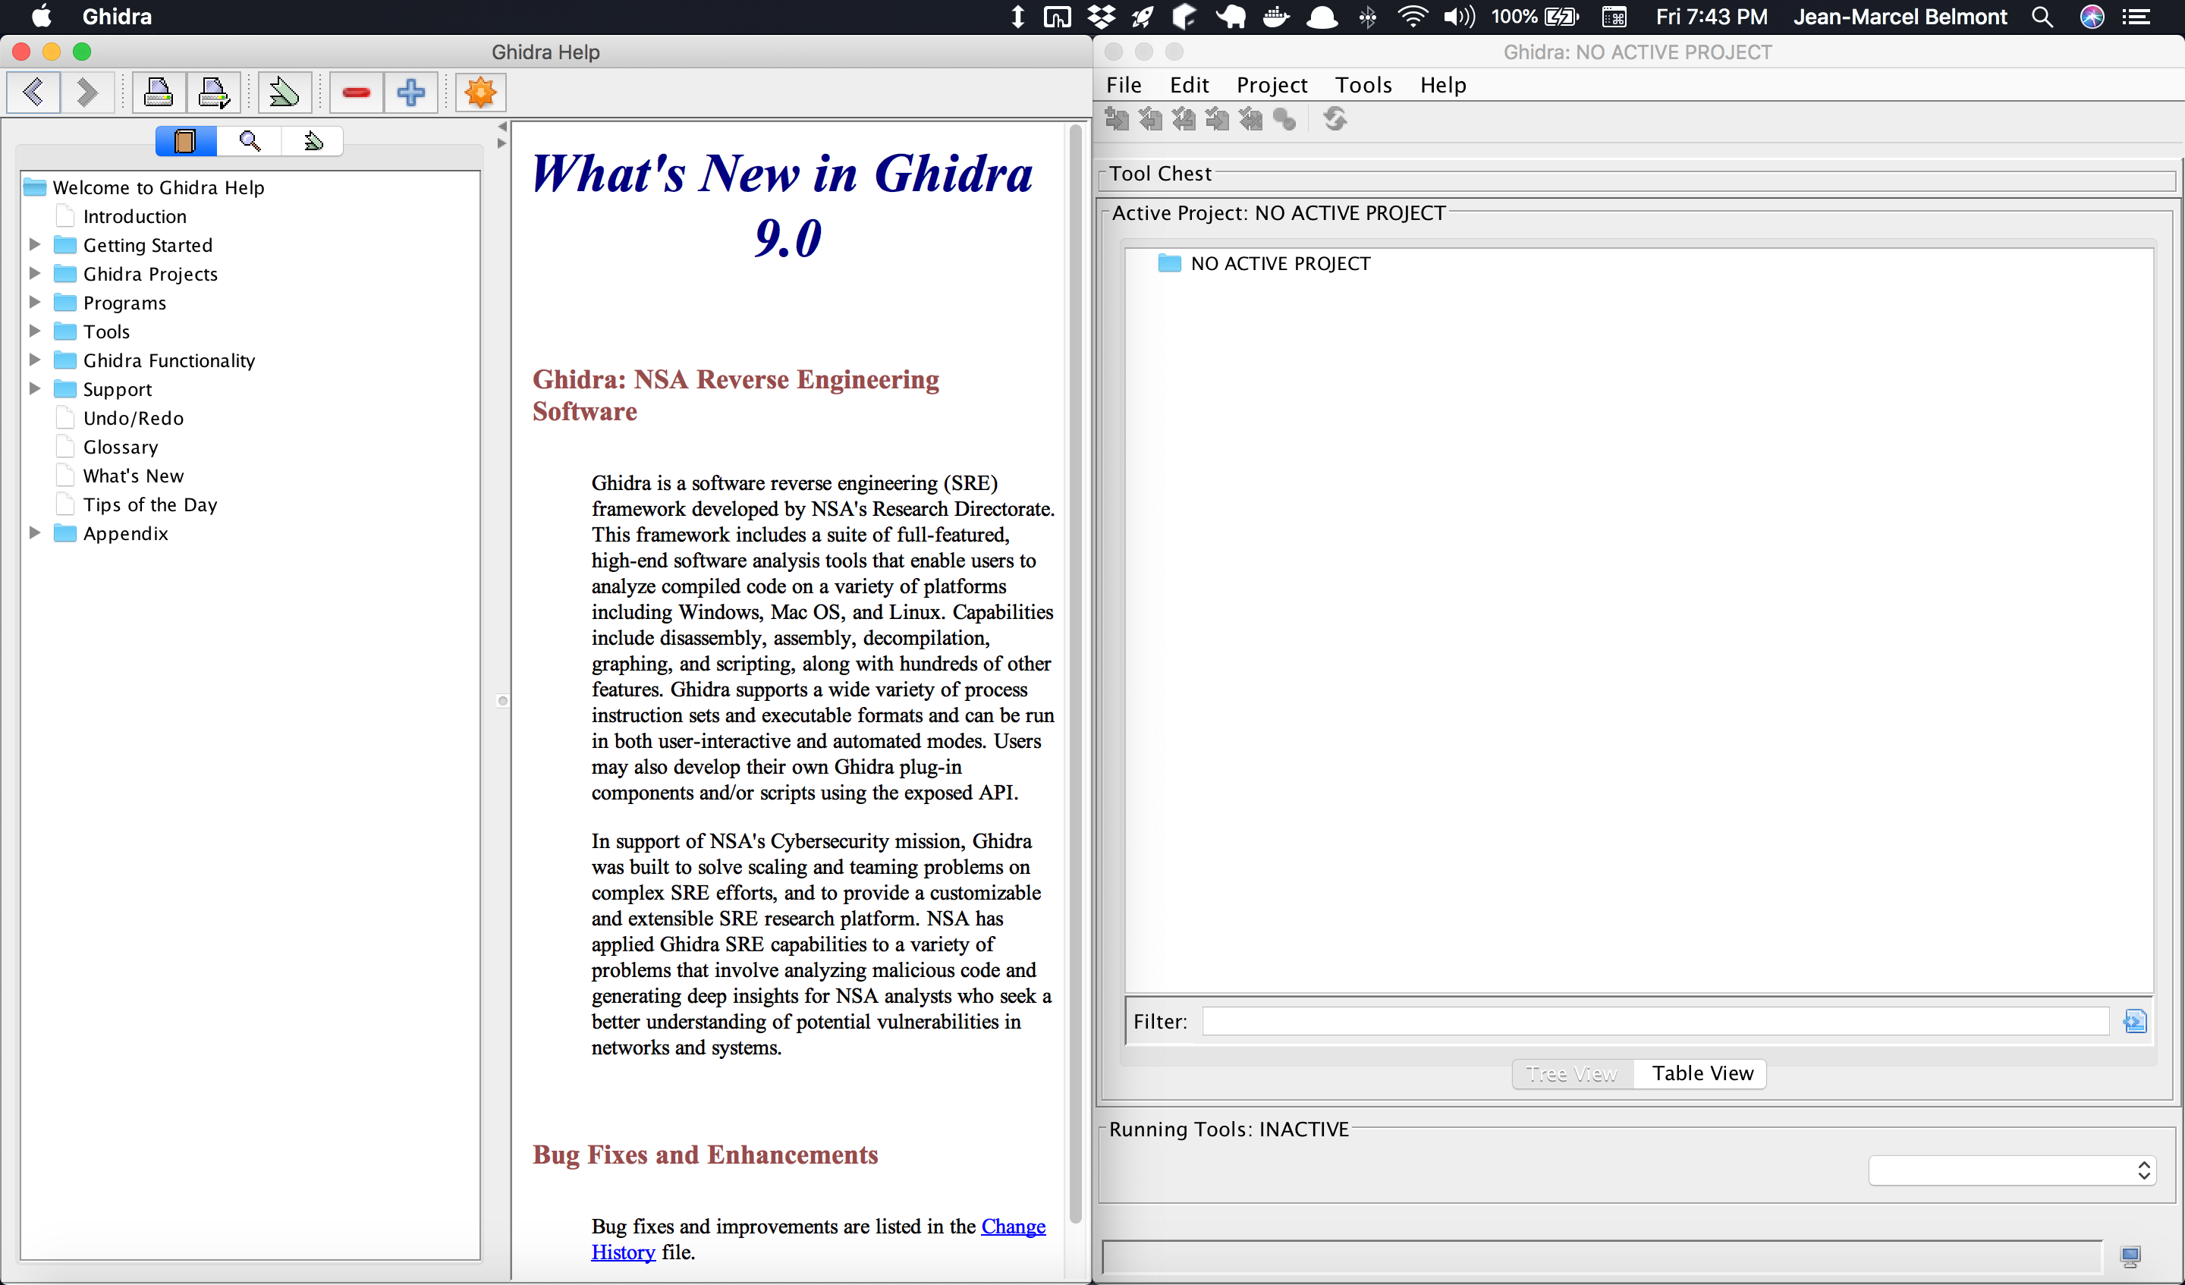
Setup Ghidra on local machine and setup new project
Notes:
Here we we are looking first at a new project and help menu when ghidra first runs on a your machine.
The other screenshot is where I am creating a new ghidra project in my machine. Ghidra is a standalone java application that you can run.

Slide 18
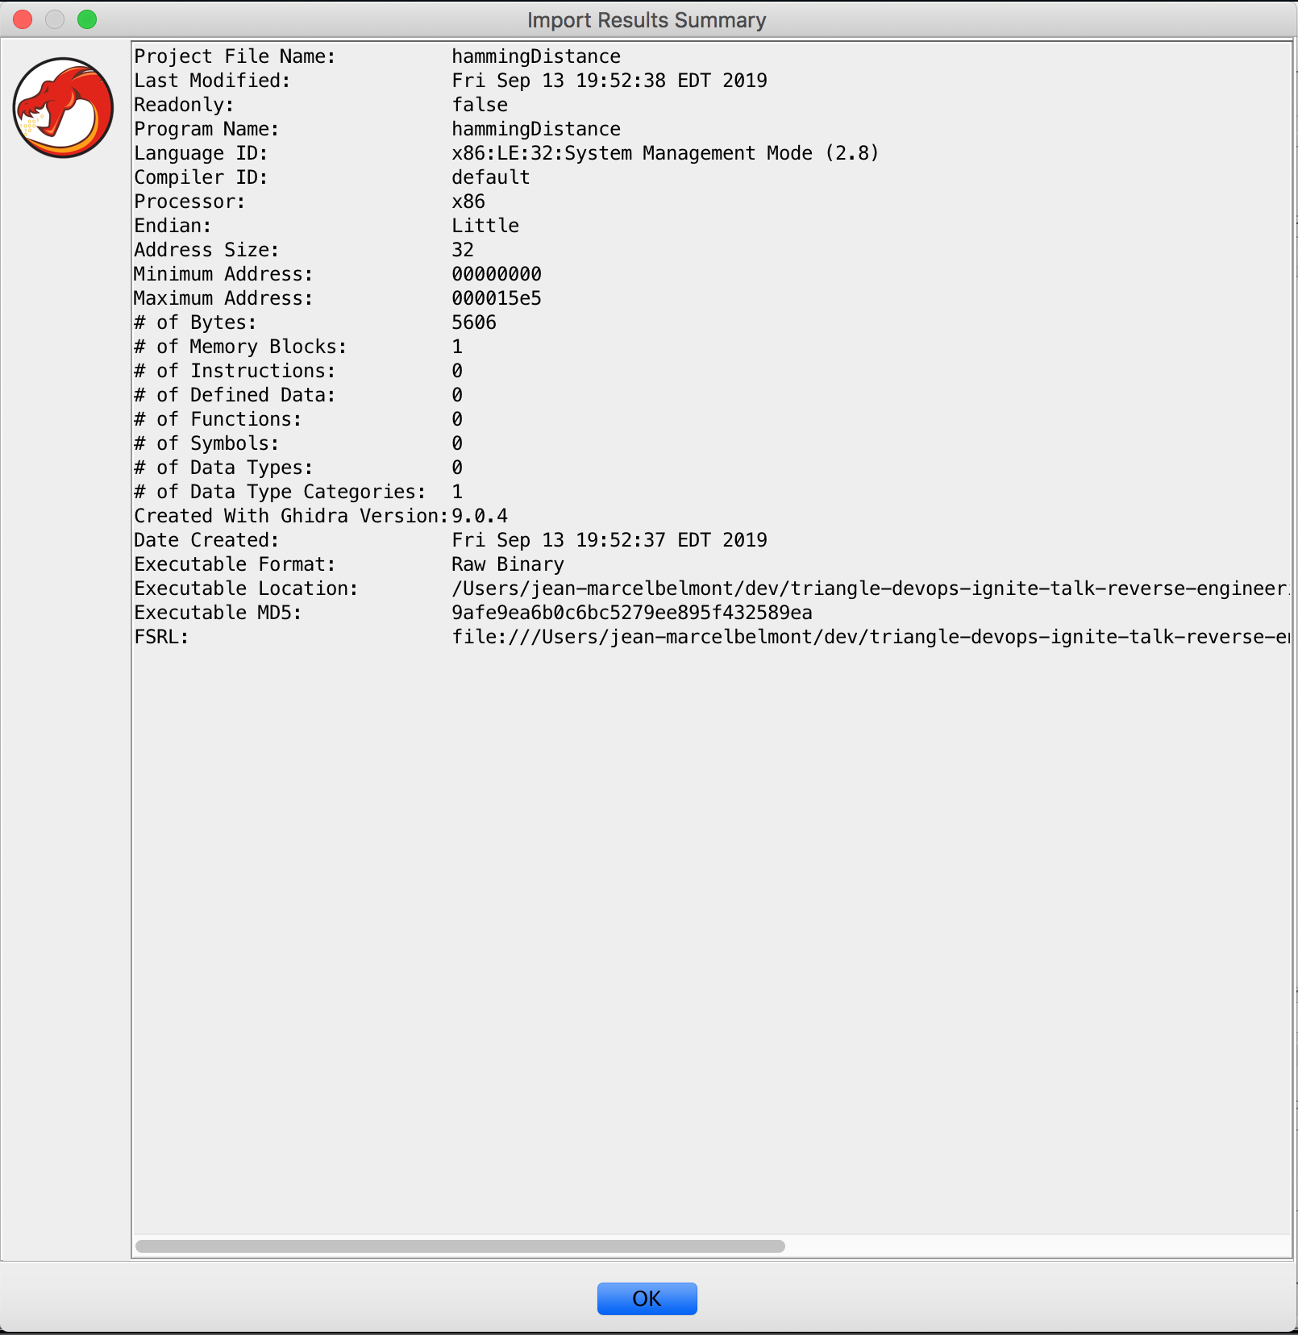
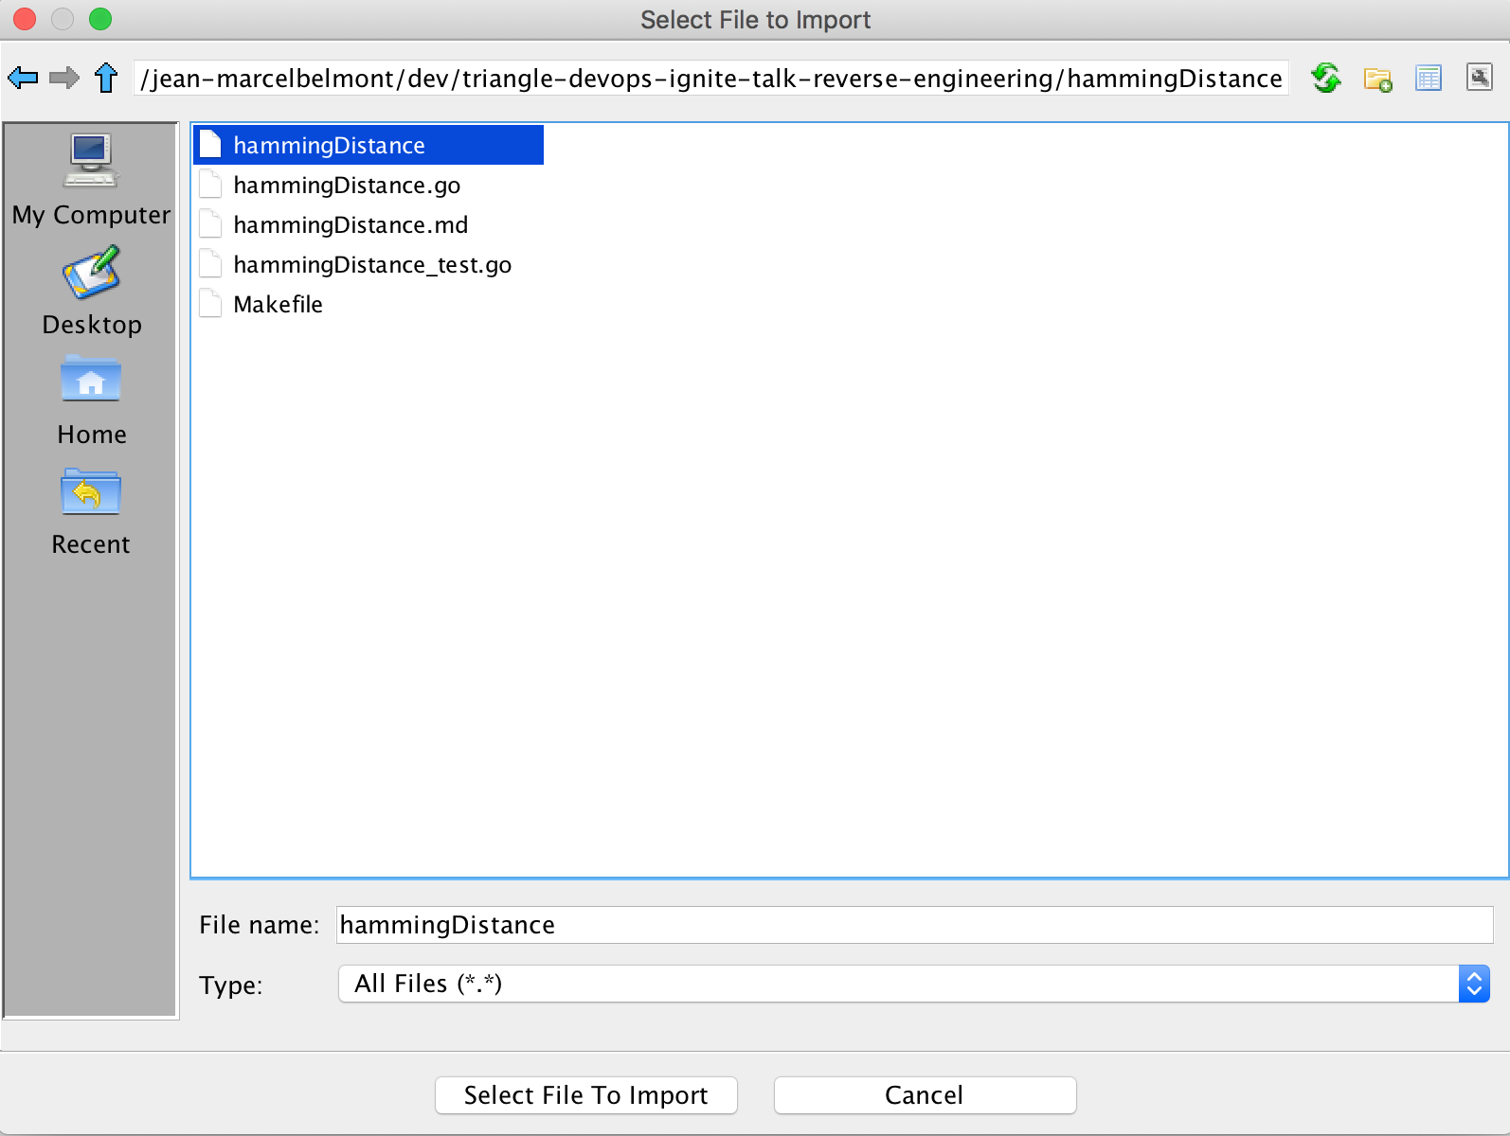
Importing binary executable and doing analysis with Ghidra
Notes:
In this next part we are simply importing the hammingDistance go binary into Ghidra so that we can then run analysis on this binary executable!

Slide 19
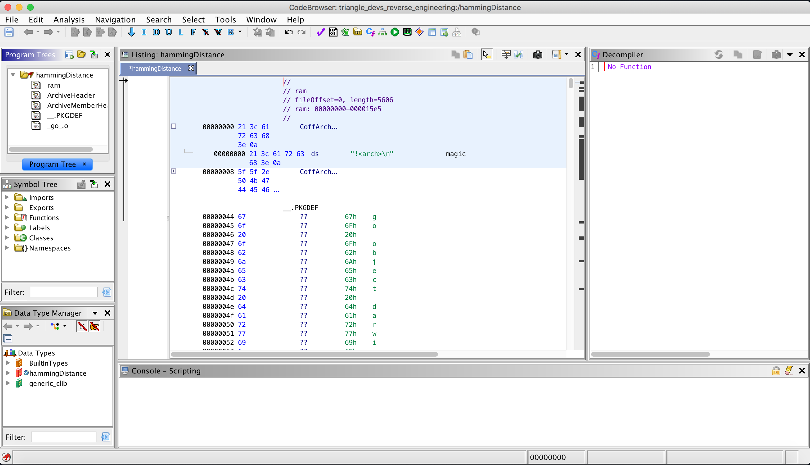
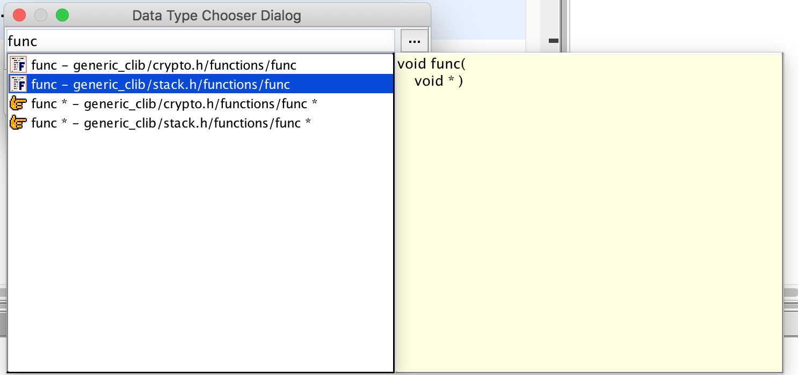
Running analysis with Ghidra (CodeBrowser)
Notes:
In here we are looking at the binary analysis with the CodeBrowser Ghidra Tool.
Additionally we are looking at some generic c functions in the other screenshot

Slide 20
Thank You
Jean-Marcel Belmont
@jbelmont80
Software Engineer
FoodLogiQ
Code can and slides can be found at:
https://github.com/jbelmont/triangle-devops-ignite-talk-reverse-engineering
Notes:
Hopefully with this talk you have received a glimpse at possible Reverse Engineering tools that you can use as a DevOps Engineer.
Thanks for your time and I hope that some of this was useful to you all!

